Slide 1
Siebel CRM Training
Accenture Siebel Methods
Notes:
Time: Lecture: 45 - 60 minutes; no labs
Intent: To introduce Accenture Siebel Methods so participants are familiar with the methodology and are able to reference and incorporate best practices into their projects
Flow: Accenture Siebel Methods, Navigation, Configuration Strategies
Siebel Core Developer and Technology School

Slide 2
Module Objectives
After completing this module you will be able to:
Describe Accenture Siebel Methods
Describe the components of Accenture Siebel Methods
Describe how to navigate through Accenture Siebel Methods
Why you need to know:
Enables you to incorporate the Accenture Siebel Methodology in your project.
Enables you to leverage deliverables from successful past projects.
Notes:
Faculty: Discuss each objective and “why you need to know” with the class.
At the end of this module, you will be able to :
Identify Accenture’s Siebel Methods.
Navigate through Siebel Methods.
Establish guidelines for Siebel to be configured to meet client needs.

Slide 3
What is Accenture Siebel Methods?
Accenture Siebel Methods
  Part of Accenture Delivery Methods Library
  Application development and implementation methodology
  Provides:
    Estimating modules (bottom up & top down)
    Deliverable samples & templates
    Job aids
    Checklist for performing quality reviews
    Reference materials that provide overview on key subject areas
How is Accenture Siebel Methods different from Packaged Development Methods?
How is Accenture Siebel Methods different from Siebel’s methodology?
Notes:
Deliverables contain the following information:
Description- A short description of the deliverable.
Roles- The skill sets that are needed to execute the work (responsible roles) and skill sets that are needed to assist or review the work (secondary roles).
Template- A Microsoft Office template you can use to create the deliverable; many of the templates are annotated to help you complete the deliverable.
Sample- An example of a completed deliverable.
Job aids provide additional guidance for completing a task or deliverable. There are three types:
Overview- Provides a description of key concepts and background information.
Guidelines- Provides specific information on issues, considerations, and approaches for completing a task.
Technique- Provides specific information on a specific approach or method of achieving a result.
Checklists provide tools for quick quality checks at key points in the process. Each checklist comes with an attachment, allowing you to easily download a copy of a checklist, customize it as necessary for your project, complete it, and store it with your project deliverables.
External references are links to additional resources outside this methodology, including references to internal databases, web sites, book descriptions, and other methodologies
Accenture Siebel Methods has been designed to support the implementation of Siebel for our clients. It is tailored from the core Packaged Development Methods to meet the specific needs in implementing Siebel.
Siebel’s methodology (Part II – virtual self study) is important to review and understand as part of the Core Consultant Certification process and should be used only for the CCC exam. Accenture’s Siebel Method on the other hand, is the recommended methodology for use on projects for all Accenture resources.

Slide 4
Why did we do this?
Accenture Siebel Methods has three main objectives:
  Improve the consistency & efficiency of solution delivery for CRM packaged solutions
  Improve the consistency & accuracy of job estimates
  Enable our people to better leverage the successes of past solution delivery projects
Notes:
This methodology was created to:
Improve the consistency & efficiency of solution delivery for CRM packaged solutions.
Improve the consistency & accuracy of job estimates.
Enable our people to better leverage the successes of past solution delivery projects.

Slide 5
Who should use the Methodology?
Anyone can use the methodology to help with proposal development, tailoring the project scope/approach, estimating the work, or executing the work. The methodology is especially recommended for:
Siebel Configurators & Siebel Technical Architects:
  to understand the activities/tasks that should be completed in each stage (Analyze, Design, Build and Test).
  to understand the inputs and deliverables that should be used and completed for each activity and task.
  to review and understand the key considerations for each activity and task.
  to understand your role and responsibility for each activity and task.
  to leverage deliverable templates, sample deliverables, job aids, checklist.
Notes:
For example, during the test stage you should refer to Siebel Methods to:
Plan the Test:
Understand the key objectives for each type of test
Tips on what should be included in the test approach document
Tips on how to write test conditions and expected results
Tips on how to create test cycles
Tips on how to validate your test plan and approach
Review the key considerations for each test stage
To view test deliverable templates and sample deliverables
For links to other job aids and check lists
Prepare and Execute the Test:
Tips on how to establish the test environment
Tips on how to create test scripts
Tips on how to create/update common test data
Tips on how to execute the test
Tips on how to perform fixes
Review the key considerations for each test stage
To view test deliverable templates and sample deliverables
For links to other job aids and check lists

Slide 6
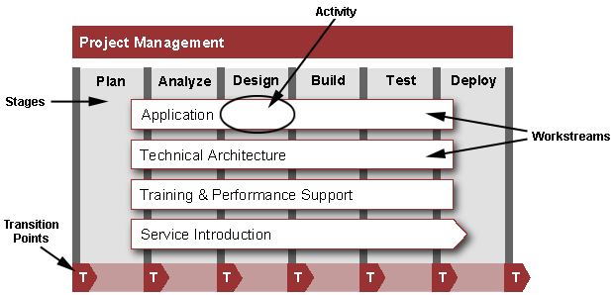
Methodology Components
Notes:
This methodology consists of the following:
Stages: the vertical bars are the stages of work within a project.
Workstream: the horizontal bars are workstreams, defined as a domain or area of work.
Activities are large units of work with a single major outcome. For example, the Design Application activity results in the Application Design deliverables. Activities are composed of tasks.
Tasks are smaller units of work that are performed by one individual or team to create a single primary outcome. Tasks, in turn, are composed of steps.
Transition Points are a special kind of task dedicated to transitioning already validated deliverables to the next team responsible for continuing the project. For example, Transition Application Design provides you with information on what the design team needs to transition to the build team, and what the critical outcomes should be.

Slide 7
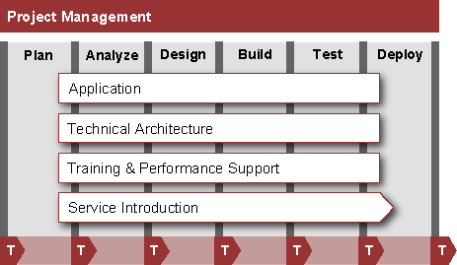
Accenture Siebel Methods: Stages
The 6 stages are: Plan, Analyze, Design, Build, Test, and Deploy.
Notes:
Siebel Methods consists of six phases:
The vertical bars are the stages of work within a project.
Plan. Define Solution Blueprint and organize the project (determine the business goals, scope, and high-level requirements of the project).
Analyze. Gather, identify, analyze, and manage the requirements. Evaluate packaged software and select technology infrastructure components. Determine environmental and process needs to support the new capability.
Design. Design the applications, technical architecture, technical infrastructure, and application training.
Build. Develop the applications, technical architecture, technical infrastructure, and application training.
Test. Test components built by all workstreams and validate the solution with users.
Deploy. Roll out the application, technical architecture, technical infrastructure, and training to the organization.

Slide 8
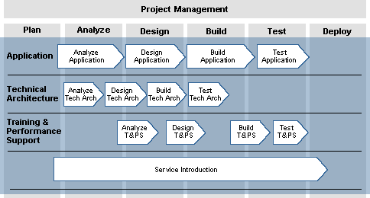
Accenture Siebel Methods: Workstreams
The 5 workstreams are: Project Management, Application, Technical Architecture, Training and Performance Support and Service Introduction.
Workstreams
Notes:
Siebel Methods consists of five workstreams:.
The horizontal bars are workstreams, defined as a domain or area of work. Workstreams group together tasks usually performed by a team of people with related skill sets.
Project Management. Determine the project work effort and resources; manage risks, issues, quality, scope, and finances; create and maintain project standards; control project work; measure progress; and report status. Project management is shown separately because it spans the entire life cycle of the project, and has many of the same activities performed on an iterative nature.
Application. Develop the systems to support the solution. This includes the user interface, content, business logic, and data.
Technical Architecture. Develop the execution environment, development environment, and operations environment, as defined today in SAF.
Training and Performance Support. Develop the organizational, educational, performance support, and communication materials needed to support the use of the solution.
Service Introduction. Validate the operability of the application while determining what the application management unit needs to do to be ready to support the application.

Slide 9
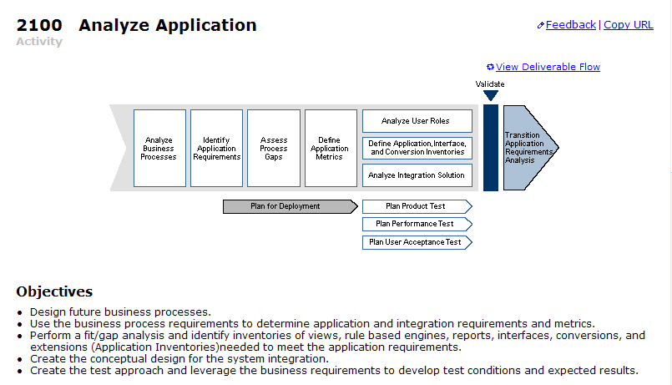
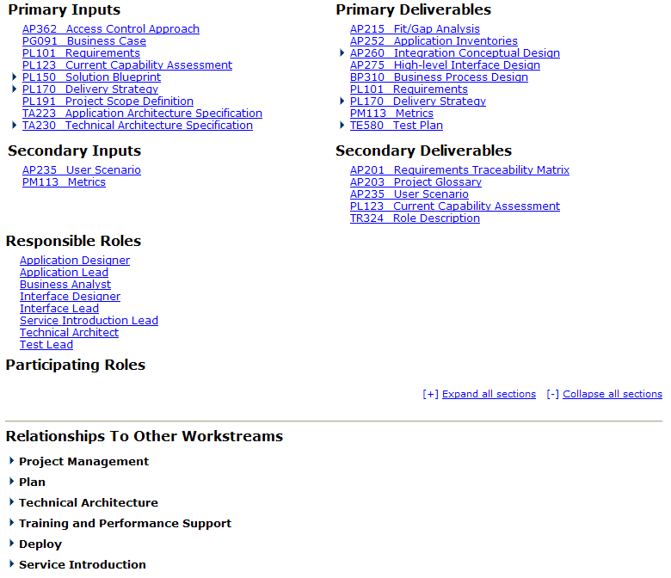
Accenture Siebel Methods: Activities
Activities are large units of work with a single major outcome. Activities are composed of tasks.
(For example: Activity 2100- Analyze Application)
Notes:
In each activity, you will find the following information:
Planning Chart. Schematic of tasks for the activity, showing their sequence and relationship.
Deliverable Flow. Schematic of deliverables for the activity. You can toggle from the process view to the deliverable view by clicking a link immediately below the schematic.
Objectives. A list of the principle objectives and outcomes of the activity.
Inputs and Deliverables. The inputs and outputs of the activity, grouped by which deliverables are critical (primary) and which are useful but not essential (secondary).
Roles. The skill sets that are needed to execute the work (responsible roles) and skill sets that are needed to assist or review the work (secondary roles).
Relationship to Other Workstreams. A description of the dependencies between this activity and activities in other workstreams.
Considerations. The key issues to consider for planning, managing, staffing, and successfully completing the activity.
See Also. A list of additional references both within the methodology and external to it.
Job Aids
Checklists
Related Processes
Reference Materials

Slide 10
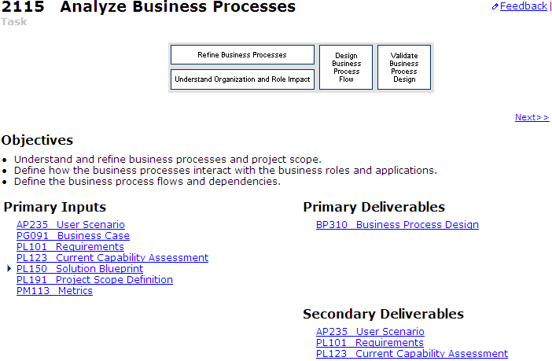
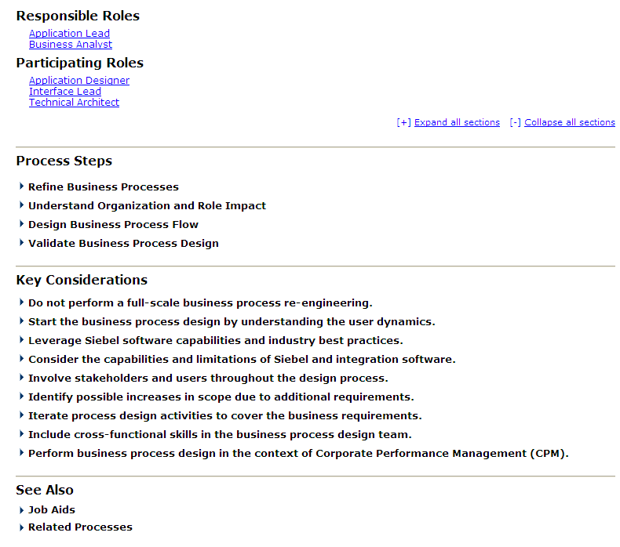
Accenture Siebel Methods: Tasks
Tasks are smaller units of work that are performed by an individual or team to create a single primary outcome. Tasks are composed of steps.
(For example: Task 2115- Analyze Business Processes)
Notes:
Task documents are written for the team member executing the work. In each task, you will find the following information:
Planning Chart. A schematic of steps for the task.
Objectives. A list of the principle objectives and outcomes of the activity.
Inputs and Deliverables. The inputs and outputs of the task, grouped by which deliverables are critical (primary), and which are useful but not essential (secondary).
Roles. The skill sets that are needed to execute the work (responsible roles) and skill sets that are needed to assist or review the work (secondary roles).
Process Steps. A description of each step in the planning chart.
Key Considerations. The key issues to consider for planning, managing, staffing, and successfully completing the activity.
See Also. A list of additional references both within the methodology and external to it.
Job Aids
Checklists
Related Processes
Reference Materials

Slide 11
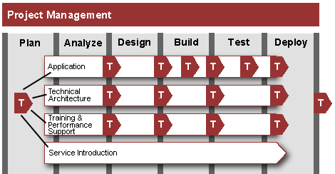
Accenture Siebel Methods:
Transition Points
Transition points occur after every activity and any other key project transition points.
Notes:
A transition point represents an interface between two teams on a project. At a transition point, project deliverables (requirements, design documents, code, etc.) transfer from one team to another. The main purposes of the transition points are to:
Ensure the quality of deliverables being transitioned.
Foster effective communication between the sending and receiving teams.
All projects use the transition point process.* Though in many projects, the transition may be within the same location from one team to another (Build team to Test team)
However if you use the Delivery Centers, geographic separation or time zone differences can magnify any miscommunication. Also, a multi-site project may involve multiple workforces and cultures, making the transition point process even more critical.**
Transition points effectively ensure teams communicate and interact at key points during the project's development life cycle; however, do not overlook traditional communication channels, such as status reporting and periodical issue resolution meetings, as the foundation for a solid communication program between the teams.
*For more information about transition points- refer to Siebel Methods/Reference Materials- Transition Point Overview.
**For more information about offshore development/delivery centers- refer to Siebel Methods/Reference Materials- Distributed Work Model.

Slide 12
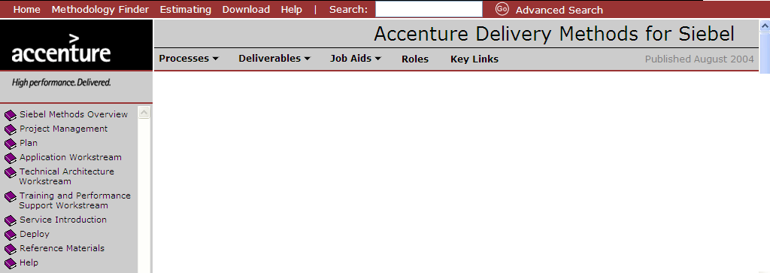
Navigating the Methodology Browser
What are the key features of the Methodology Browser?
Utility Bar
Functional
Navigation
The Methodology Browser is the navigation tool used for all core methodologies. It has the following features to help you navigate through the methodology and access other tools to help you. These features include:
Utility Bar
Functional Navigational Bar
Table of Contents
Table of
Contents
Notes:
Utility Bar
The utility bar provides access to basic utilities for the site. It appears at the top of the Browser.
Clicking each option displays the following:
Home. Links to the methodology’s home page.
Methodology Finder. Displays the Methodology Finder in a new window.
Estimating. Links to the Siebel Estimating page (Bottom- Up and Top-down) and also provides link to download the tools.
Download. Links to the Siebel Methods Download page, which provides access to download an offline versions of the methodology.
Help. Answers key questions about the features and functions of the Methodology Browser, and provides access to information about using the methodology.
Search. Displays the Enterprise Search page, allowing you to search within the methodology as well as more broadly through our assets.
Functional Navigation Bar
The functional navigation bar, immediately below the banner, provides fast access to methodology content organized by content type, including the following:
Processes. Ability to view Activities, Tasks, Transition Points alphabetically or by ID.
Deliverables. Ability to view all deliverables alphabetically or in hierarchy.
Job aids. Ability to view job aids alphabetically or by workstream. Also able to view checklist alphabetically or by activity.
Roles. Ability to view role types alphabetically.
Key Links provides quick access to groups of assets that may prove particularly useful when using the methodology.
Table of Contents
The table of contents appears in the left-hand column, below the Accenture logo. It provides structured access to all the content in the methodology, organized by key method areas.

Slide 13
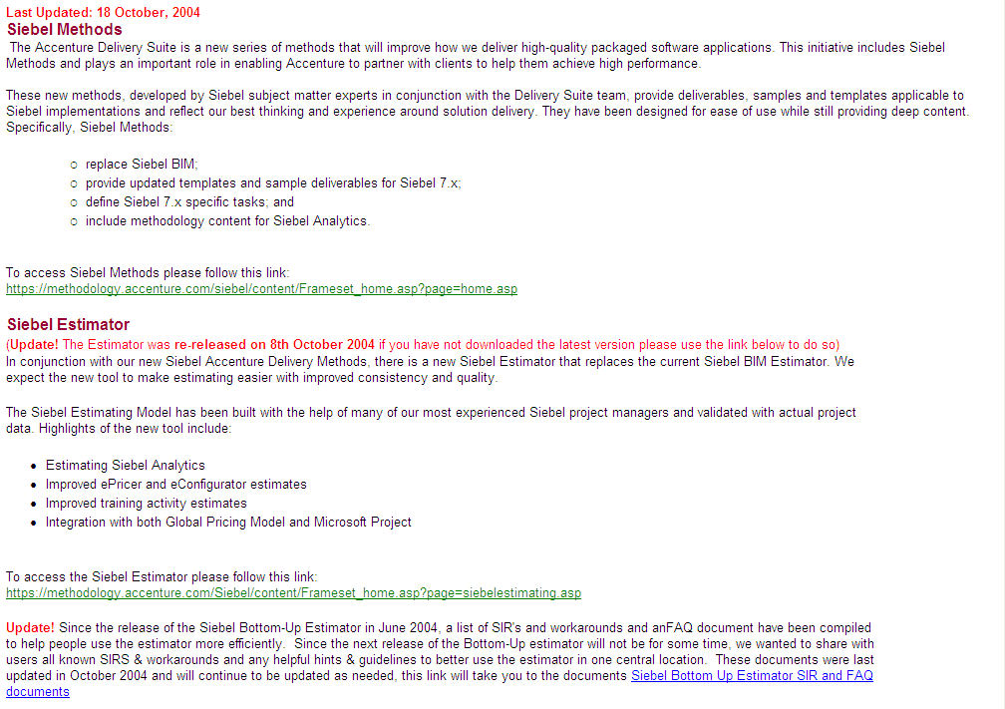
How do I access
Accenture Siebel Methods?
Online version
  Accenture Siebel Methods can be accessed through the CRM Practice Aid web site; however, most of your managers should already have it loaded and available on your projects.
Notes:
While the Siebel Methods can be used as-is from the central web site, a project team also has the option of tailoring the methodology content to meet its unique situation. To leverage this option, a project team can install a copy of the methodology on its project server and use Microsoft FrontPage to add or remove processes and deliverables relevant to their project or to edit the content of any document. The project-customized methodology can also be configured to integrate with the project’s underlying document repository.
*For more information on how to customize Siebel Methods for your project, refer to Siebel Methods/Reference Materials- Methods Customization.
Go to CRM Practice Aid (https://crcld1106.accenture.com/Applications/PRACTICE/process/PACRM.nsf) and click ‘Siebel Practice Home Page.’ Select ‘Delivery Methods’ Select ‘Siebel Methods and Siebel Estimator link.’ Select ‘To access Siebel Methods please follow this link.’

Slide 14
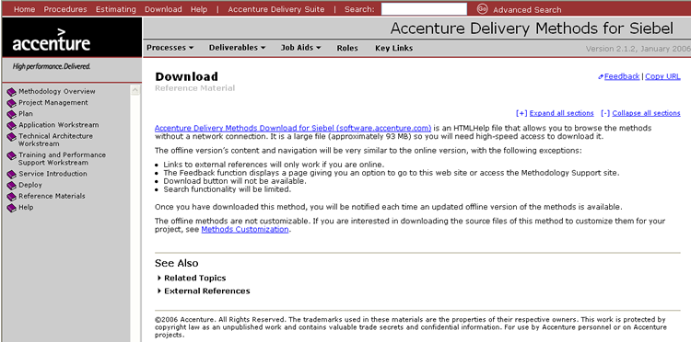
How do I access
Accenture Siebel Methods?
Offline version
  Siebel Download (software.accenture.com) is an HTML Help file that allows you to browse the methods without a network connection. It is a large file (approximately 58 MB) so you will need high-speed access to download it.
Notes:
The offline version’s content and navigation will be very similar to the online version, with the following exceptions:
Links to external references will only work if you are online.
Feedback/Contact Us functions will display pages giving you an option to go to the web site, eSupport, or call the Support Center.
Download button will not be available.
Search functionality will be limited.
Once you have downloaded this method, you will be notified each time an updated offline version of the methods is available.
The offline methods are not customizable.

Slide 15
Accenture Siebel Methods Training
For additional training and information on Siebel Methods, please refer to Siebel Methods Training available on Mylearning:
  Siebel Methods Overview session via myLearning: https://mylearning.accenture.com/asp/LMSLink.asp?file=catalog/activity.jsm&&ID=26851
  Siebel Methods (ADM) Application Workstream session via myLearning: https://mylearning.accenture.com/asp/LMSLink.asp?file=catalog/activity.jsm&&ID=27042
Notes:
Siebel Methods Training
To help Siebel practitioners get up to speed a Siebel Methods training session was held. Each person should plan on taking the Siebel Methods (ADM) Overview class, as well as a class specific to the role they typically play on a Siebel engagement. For Siebel application / interface designers and developers, we have created a specific class on the Siebel Methods Application Workstream. All others should attend a class for their role based on Packaged Methods.

Slide 16
Summary
This module showed you how to:
Describe Accenture Siebel Methods
Describe the components of Accenture Siebel Methods
Describe how to navigate through Accenture Siebel Methods
Configuration Guidelines
You should refer to the Siebel Resources module for information on our suite of assets and tools available to support you and how to access and use these.
Notes:
Review Question: When do you use Accenture’s Siebel Methodology and when do you use Siebel’s Methodology?
Answer: Use Accenture’s Siebel Methodology (which is covered in this module) for all Siebel projects. Refer to Siebel’s Methodology (which is covered in Part II – Self-study training) for the Siebel 7.7 Core Consulting Certification Exam.
Review Question: What are the two ways to access the Accenture Siebel Methodology?
Answer: Online – Accenture Siebel Methods can be accessed through the CRM Practice Aid/Siebel Home Page/Delivery Methods/Siebel Methods & Siebel Estimator link. Offline – Download offline version via: Software.accenture.com
For the remaining questions, please open Siebel Methods to find the answers:
Review Question: Name the four primary deliverables for Application – Detailed Technical Design.
Answer: (Select application workstream from table of contents/select "Perform Detailed Technical Design" from the Build Stage (Drawing)/this will take you to: 4155 Perform Detailed Technical Design)
AP370 Data Conversion Design
AP450 Customization Technical Design
AP475 Integration Technical Design
AP481 Interface Agreement
Review Question: What are some key considerations for the technical architects when designing the execution environment?:
Answer: (select technical application workstream from table of contents/select "Select and Design Execution Environment from the Design Stage (Drawing)/this will take you to:3355 Select and Design Execution Environment)
Consider reusable solutions.
Ensure all key architecture requirements are taken into account.
Define the selection process and decision criteria.
Conduct a pilot prior to procurement.
Identify the solution with best fit to requirements.
Consider and leverage existing public components and code.
Use multiple, integrated best-of-breed solutions only when necessary.
Accurately determine the number of users.
Determine what system availability requirements exist.
Consider trade-offs between hardware and software-based solutions.
Leverage investments in the current packages/technologies.
Review Question: Identify two ways to find an AssemblyTest Approach template or sample deliverable?
Answer: Go to the following task: 3182 Plan Assembly Test and double click on the deliverable name "TE582 Test Approach" under Primary Deliverables OR
Go directly to Deliverables from the functional navigational bar and either use view by alphabetically and find "TE582 Test Approach" or view by hierarchy and find "TE582 Test Approach" under Testing

